Slide 1
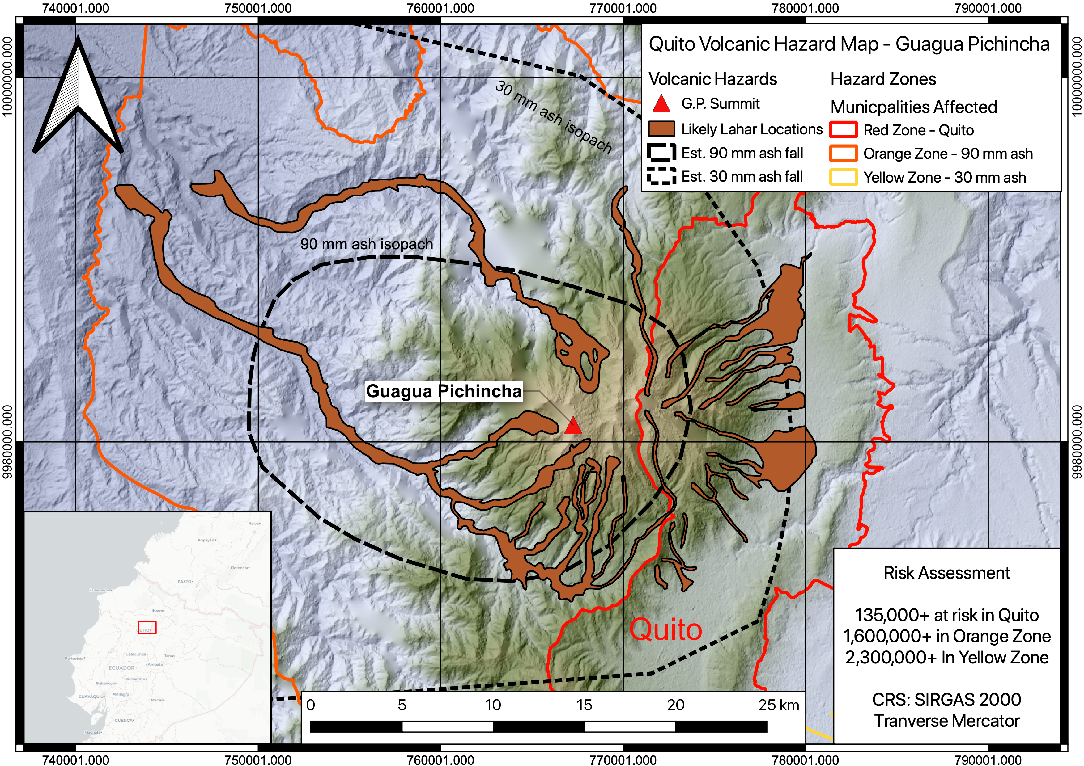
GIS for Geoscientists Session 2: Beginner GIS
Presented by Nicholas Barber, 4th Year PhD Student at the University of Cambridge, U.K.
ndb38@cam.ac.uk | www.volcannick.com | https://github.com/ndb38 | Twitter @volcannick

Slide 2
Finding Data

Slide 3
Where in the world do I find data?
Think in detail about our question: what do we need to have?
Information on volcano
Geology
Estimated hazards
Location
Severity
Geochemistry/Geophysics?
Information on surrounding population
Infrastructure?
Hydrology
Municipal boundaries
Location of Major population centers
Population #
Demography?
Information on topography

Slide 4
Where in the world do I find data?
Think in detail about our question: what do we need to have?
Information on volcano
Geology
Estimated hazards
Location
Severity
Geochemistry/Geophysics?
Information on surrounding population
Infrastructure?
Hydrology
Municipal boundaries
Location of Major population centers
Population #
Demography?
Information on topography

Slide 5
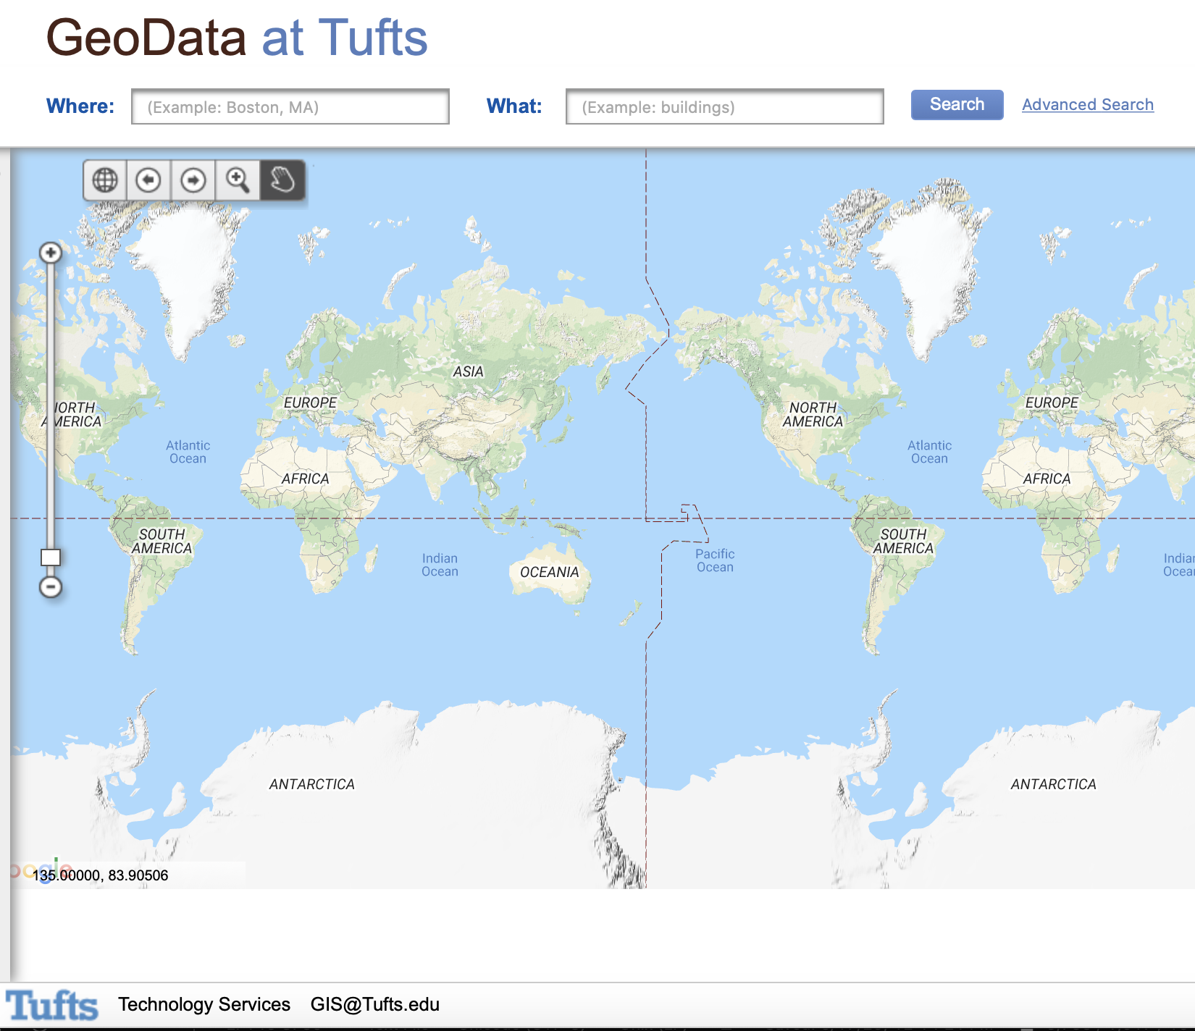
Generic Datasets (Example): https://geodata.tufts.edu

Slide 6
Other Data Sources
Economic Geology: https://mrdata.usgs.gov/general/map-global.html
Similar generic info: http://hgl.harvard.edu:8080/opengeoportal/
Humanitarian/land use data: https://geoportal.landportal.org/?gclid=CjwKCAjw_qb3BRAVEiwAvwq6Vgusj8dZX1TuJTa3ipj7r6hEaFvMbdN-ZZJ2ekZ8iNdt-FZZJnmMHhoCAWUQAvD_BwE
USGS Earth Explorer: https://earthexplorer.usgs.gov
ESRI Hub: https://hub.arcgis.com/search
Natural Earth: http://www.naturalearthdata.com/downloads/
NASA Socioeconomic data: https://sedac.ciesin.columbia.edu
LIDAR Data: https://opentopography.org
UN Data: http://geodata.grid.unep.ch
Pop and Enviro Data: https://terra.ipums.org

